Slide 1
Mutual Exclusion with a Semaphore

Slide 2
Mutual Exclusion with a Semaphore
A properly functioning multiprocessor system must provide a mechanism that will guarantee orderly access to shared memory and other shared resources. This is necessary to protect data from being changed simultaneously by two or more processors. This mechanism has been termed mutual exclusion.
Mutual exclusion must be provided in a multiprocessor system to enable one processor to exclude or lock out access to a shared resource by other processors when it is in a critical section.
A critical section is a program sequence that, once begun, must complete execution before another processor accesses the same shared resource.
Based on M. Morris Mano “Computer System Architecture”--Assist. Lecturer Ahmed Salah Hameed

Slide 3
Mutual Exclusion with a Semaphore
A semaphore is a binary variable often used to indicate whether or not a processor is executing a critical section. It is a software- controlled flag that is stored in a memory location that all processors can access.
semaphore =1, a processor is executing a critical program, so that the shared memory is not available to other processors.
semaphore =0, the shared memory is available to any requesting processor.
Based on M. Morris Mano “Computer System Architecture”--Assist. Lecturer Ahmed Salah Hameed

Slide 4
Mutual Exclusion with a Semaphore
Testing and setting and a hardware lock
The semaphore is itself a critical operation and must be performed as a single indivisible operation. If it is not, two or more processors may test the semaphore simultaneously and then each set it, allowing them to enter a critical section at the same time. This action would allow simultaneous execution of critical section, which can result in erroneous initialization of control parameters and a loss of essential information. A semaphore can be initialized by means of a test and set instruction in conjunction with a hardware lock mechanism.
A hardware lock is a processor- generated signal that serves to prevent other processors from using the system bus as long as the signal is active. The test-and-set instruction tests and sets a semaphore and activates the lock mechanism during the time that the instruction is being executed. This prevents other processors from changing the semaphore between the time that the processor is testing it and the time that it is setting it.
Based on M. Morris Mano “Computer System Architecture”--Assist. Lecturer Ahmed Salah Hameed

Slide 5
A Semaphore Example
Assume that the semaphore is a bit in the least significant position of a memory word whose address is symbolized by SEM. Let TSL designate the "test and set while locked" operation.
TSL SEM
R ←M[SEM] Test semaphore
M[SEM]←1 Set semaphore
Based on M. Morris Mano “Computer System Architecture”--Assist. Lecturer Ahmed Salah Hameed

Slide 6
Mutual Exclusion with a Semaphore
If R = 1, it means that the semaphore was originally set, that means that another processor is executing a critical section, so the processor that checked the semaphore does not access the shared memory.
If R = 0, it means that the common memory (or the shared resource that the semaphore represents) is available. The semaphore is set to 1 to prevent other processors from accessing memory. The processor can now execute the critical section.
The last instruction in the program must clear location SEM to zero to release the shared resource to other processors.
The semaphore itself, when set, prevents other processors from accessing shared memory while one processor is executing a critical section.
Based on M. Morris Mano “Computer System Architecture”--Assist. Lecturer Ahmed Salah Hameed

Slide 7
Cache Coherence
The primary advantage of cache is its ability to reduce the average access time in uniprocessors.
Read procedures
When the processor finds a word in cache during a read operation, the main memory is not involved in the transfer.
Write procedures
write-through policy :both cache and main memory are updated with every write operation.
write-back policy, only the cache is updated and the location is marked so that it can be copied later into main memory.
What is cache coherence problem?
Cache coherence problems exist in multiprocessors with private caches because of the need to share writable data. Read-only data can safely be replicated without cache coherence enforcement mechanisms.
Based on M. Morris Mano “Computer System Architecture”--Assist. Lecturer Ahmed Salah Hameed

Slide 8
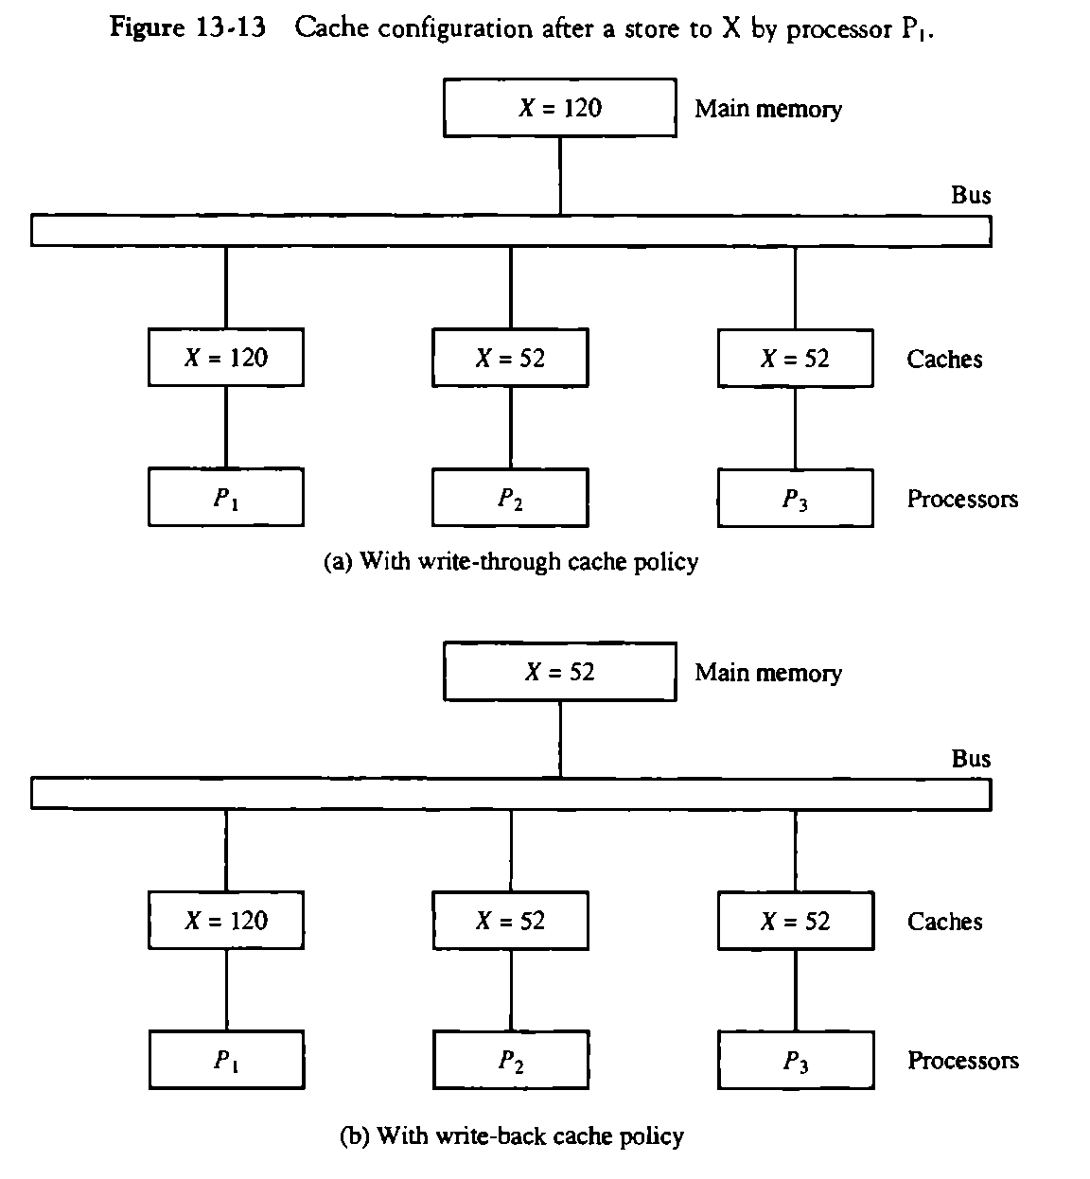
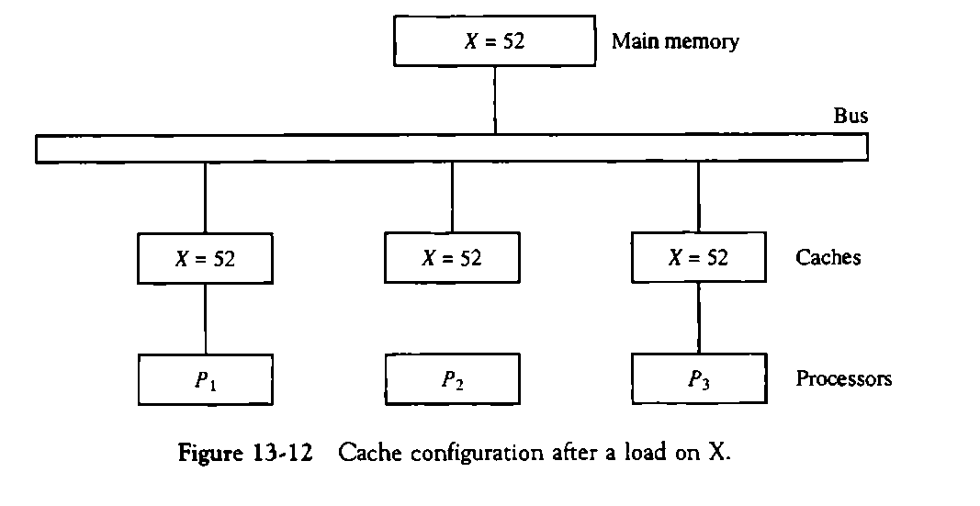
Example
Based on M. Morris Mano “Computer System Architecture”--Assist. Lecturer Ahmed Salah Hameed

Slide 9
Solutions to the Cache Coherence Problem
For performance considerations it is desirable to attach a private cache to each processor.
Solutions to the cache coherence problems
Disallow private caches for each processor and have a shared cache memory associated with main memory.
Only nonshared and read only data to be stored in caches : cachable (Shared writable data are noncachable)
Centralized global table in its compiler: A scheme that allows writable data to exist in at least one cache.
Hardware solutions:
Snoopy cache controller– monitor all bus requests
All caches constantly monitor the bus for possible write operations
Write through policy.
Based on M. Morris Mano “Computer System Architecture”--Assist. Lecturer Ahmed Salah Hameed

Slide 10
PROBLEMS
13-9. Draw a logic diagram using gates and flip-flops showing the circuit of one bus arbiter stage in the daisy-chain arbitration scheme of Fig. 13-10.
13-10. The bus controlled by the parallel arbitration logic shown in Fig. 13-11 is initially idle. Devices 2 and 3 then request the bus at the same time. Specify the input and output binary values in the encoder and decoder and determine which bus arbiter is acknowledged.
13-11. Show how the arbitration logic of Fig. 13-10 can be modified to provide a rotating daisy-chain arbitration procedure. Explain how the priority is determined once the bus line is disabled.
13-12. Consider a bus topology in which two processors communicate through a buffer in shared memory. When one processor wishes to communicate with the other processor it puts the information in the memory buffer and sets a flag. Periodically, the other processor checks the flags to determine if it has information to receive. What can be done to ensure proper synchronization and to minimize the time between sending and receiving the information?
One way to speed the transfer would be to send an interrupt request to the receiving processor.
Based on M. Morris Mano “Computer System Architecture”--Assist. Lecturer Ahmed Salah Hameed

Slide 11
PROBLEMS
13-13. Describe the following terminology associated with multiprocessors, (a) mutual exclusion; (b) critical section; (c) hardware lock; (d) semaphore; (e) test-and-set instruction.
13-14. What is cache coherence, and why is it important in shared-memory multiprocessor systems? How can the problem be resolved with a snoopy cache controller?
Based on M. Morris Mano “Computer System Architecture”--Assist. Lecturer Ahmed Salah Hameed

